Slide 1
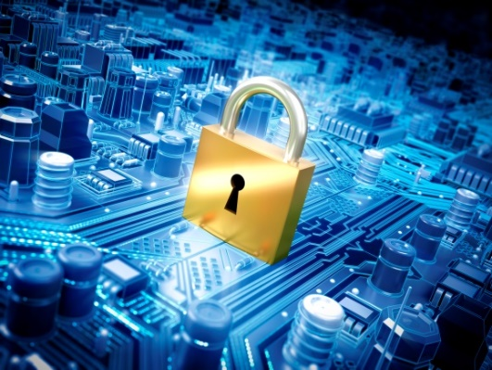
IT-648: IT Risk Management
Week 5
Sonja Streuber

Slide 2
Agenda
# | Topic | Reading | Due Sunday 11:59 pm CST on Blackboard
5 | Asset Identification and Characterization: IT asset lifecycle and asset identification, system profiling, Asset ownership and operational responsibilities | Agrawal 5 Other materials on Blackboard | W: Post F: Responses S: LAB_5

Slide 3
Chapter 5
Asset identification and characterization

Slide 4
Overview
By the end of this week, you will be able to:
Identify some of the issues involved in maintaining IT assets
Understand the mission of the organization
Classify assets based on their alignment to the organization’s mission
Describe and manage asset management issues including life cycle and ownership

Slide 5
Introduction
The goal of asset identification and classification is to proactively gather all necessary information about an organization’s assets that can be useful in responding to a threat affecting that asset.
Most organizations do not know of compromises
92% of all information security incidents in 2011 identified by third parties
E.g. law enforcement, other ISPs
Often attacks have acted for weeks or months
Adversaries are identifying your assets for their own benefit
Identification improves your own preparedness

Slide 6
Asset identification and checklists
Checklists are very effective for identification
Asset identification often done using checklists
E.g. Hurricane preparedness checklists
Information security checklists difficult to develop
Organizations are unique
What is important to a university may not be so important to a bank
But, asset identification procedures may be developed
E.g. ISO 27002
Information security standard

Slide 7
Asset identification and checklists
The International Standards Organization (ISO) has a family of standards for IT Asset Management. The ISO 19770 family consists of 4 major parts,
19770-1 is a process related standard which outlines best practices for IT Asset Management in an organization. The latest revision breaks ITAM processes down into 4 tiers in a maturity matrix.
19770-2 is a standard for machine encapsulation (in the form of an XML file known as a SWID tag) of inventory data – allowing users to easily identify what software is deployed on a given device.
19770-3 is a standard which provides a schema for machine encapsulation of entitlements and rights associated with software licenses.
19770-4 allows for standardized reporting of utilization of resources. This is crucial when considering complex datacenter license types and for management of cloud based software and hardware (SaaS and IaaS).

Slide 8
Asset types
Idiosyncratic
Distinct to an organization
E.g. student transcripts
Correct identification difficult
requires determination of the processes, procedures and activities in the organization
Considerable effort and attention to detail necessary
At a high level, asset identification and classification involves listing all IT assets in the organization, and characterizing the importance of each asset to the organization’s information security, paying attention to the IT systems within which each asset operates.

Slide 9
Identifying important assets
Bottom up
Talking to co-workers
Learning curve
Learn the inner workings of the company
Employee knowledge
Top down
Annual reports
Vision statement (Articulation of organization’s aspirations)
Mission statement (Concise expression of an organization’s services, target market and competitive advantages)
Understanding the goals of the organization from the point of view of executive leaders
“About us” on website
Mission and Vision Statements are conscious efforts to distinguish from competition; data related to these activities potentially idiosyncratic to the organization

Slide 10
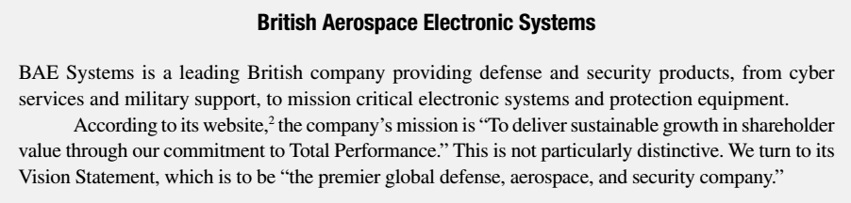
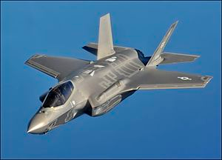
Statement examples and incidents
2007: APT used to steal design documents related to F-35 Strike Fighter
Believed to have helped Chinese government develop J-20 Fighter
F-35

Slide 11

Statement examples and incidents
July 2012: Simple security misstep in design of one service (Yahoo Voices) led to leakage of nearly 400,000 online credentials

Slide 12
Statement examples and incidents
University of Nebraska-Lincoln
“Learning that prepares students for lifetime success and leadership … Engagement with academic, business, and civic communities throughout Nebraska and the world”
May 2012: Breach in Student Information System
Potential leakage of 654,000 students’ Personal Identifiable Information including Social Security Numbers
Number (654,000) vastly exceeds student enrolment
because the university maintains records of all alumni

Slide 13
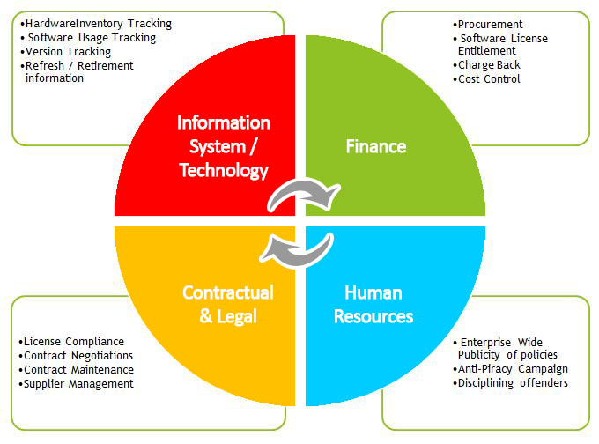
Asset types

Slide 14
Information assets
Definition
Digitally stored content owned by an individual or organization
May be stored locally or in the “cloud”
Usually the most important asset for information security
Prime target for attackers
General information assets
E.g. payroll data, cash flow data, credit card information
Idiosyncratic information assets
E.g. intellectual property, student grades
Executives generally suffer from “recency effect”
Focus on events attracting recent media attention
E.g. Credit card data theft in 2009
But other issues may be equally important (2010: RSA, Anonymous, H B Gary etc

Slide 15
Personnel assets
Employees
Take time to replace
Identify employees with idiosyncratic skills
Bring this to attention of senior management
Employee retention incentives may be necessary
Try to cross-train other employees
Contact information
Disaster response

Slide 16

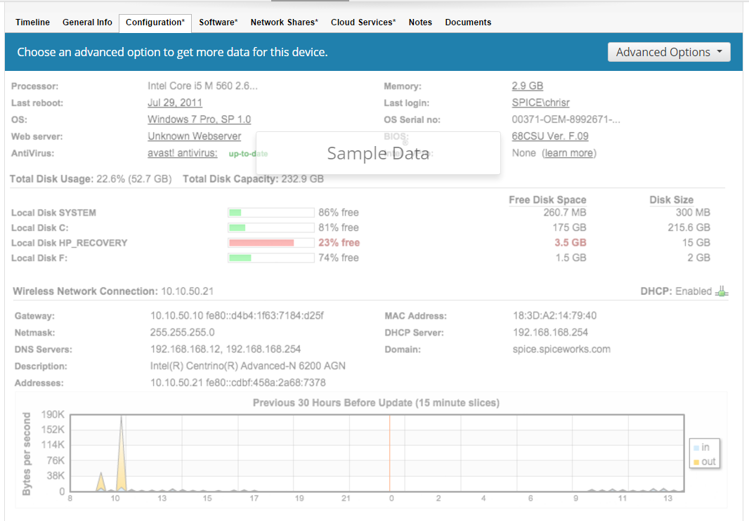
Asset Identification Software
Network asset discovery based on administrator permissions, then monitoring of asset operational stats

Slide 17
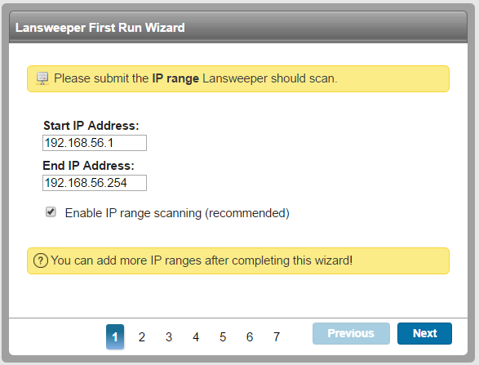

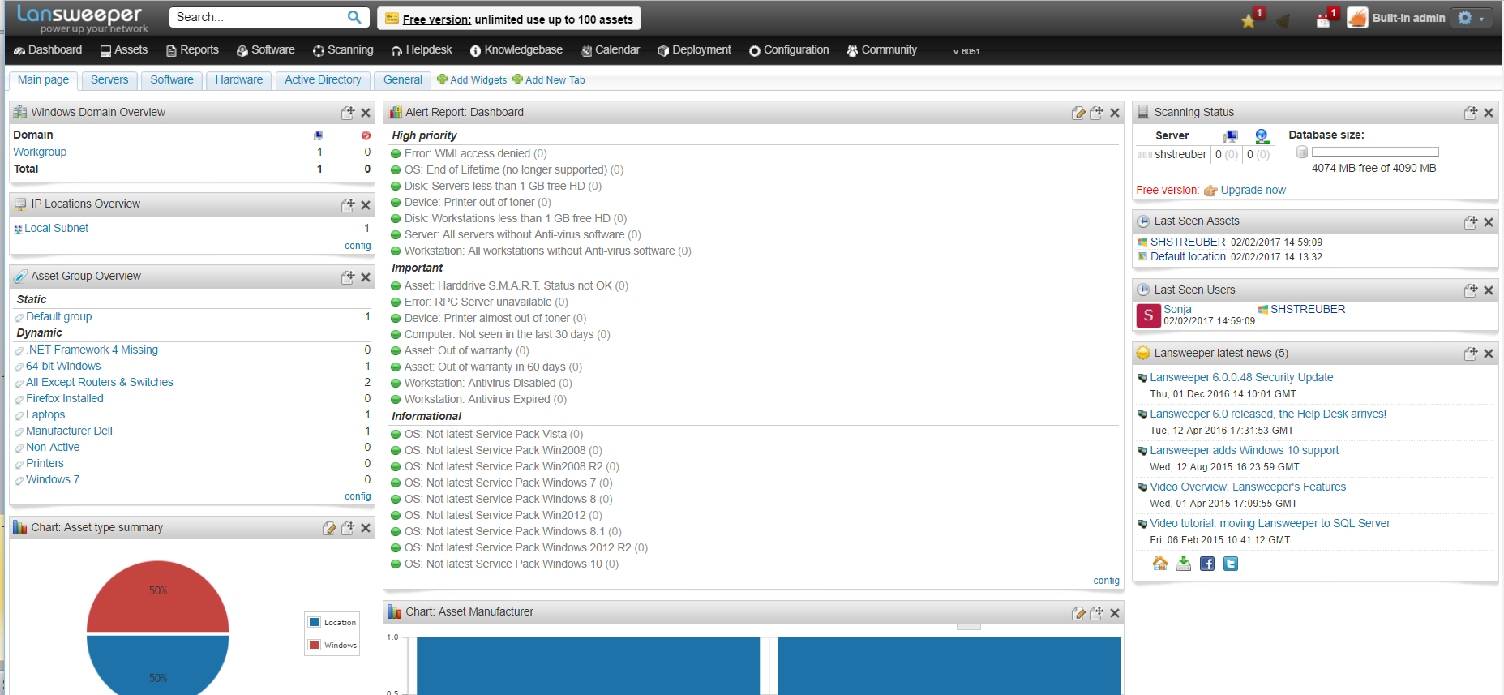
Asset Identification Software

Slide 18
Hardware assets
Machinery used to store and process information
Usually general purpose assets
Purchased from vendors
But may have special needs
E.g. Being used past vendor’s announcement of end of life
Budget constraints
Spare parts inventory
Can be idiosyncratic
Prototypes
Non-disclosure agreements (NDAs)

Slide 19
Hardware assets (contd.)
Tracking attributes
Information recorded to locate in case of theft
E.g.
Tag #
Model #
Serial #
Service tag #
Cost
End of life (estimated)
Location
Network jack
Special disposal guidelines

Slide 20
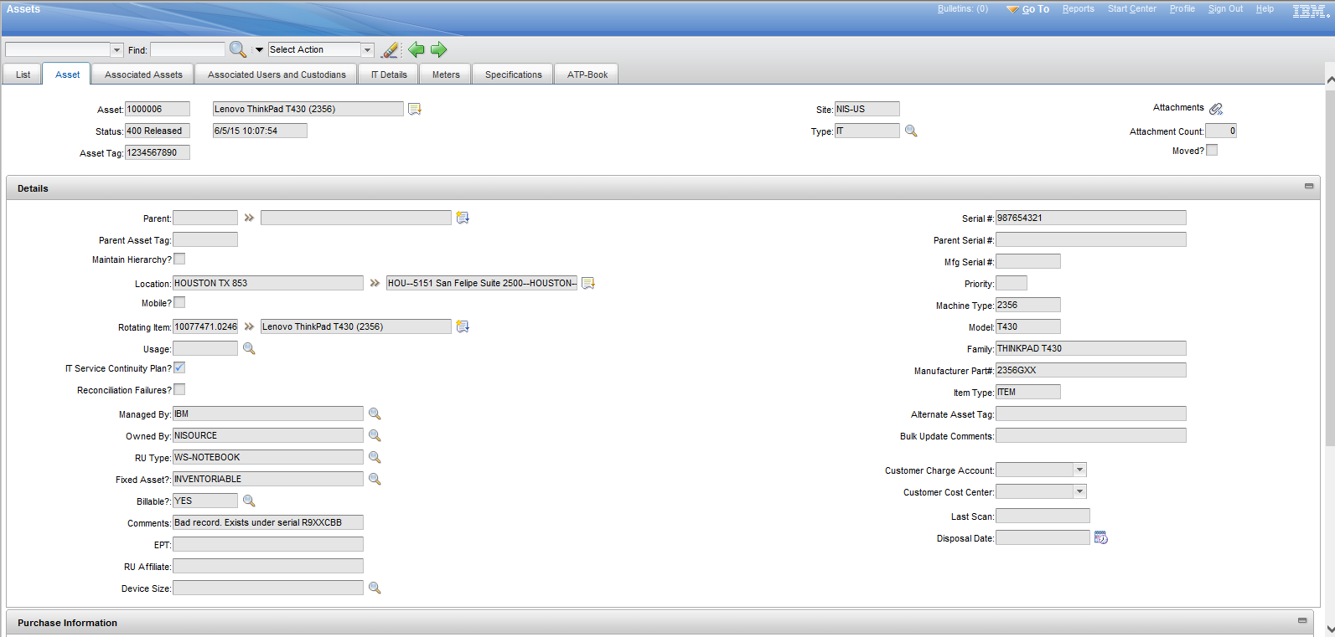
Asset Management Software
IBM Product

Slide 21
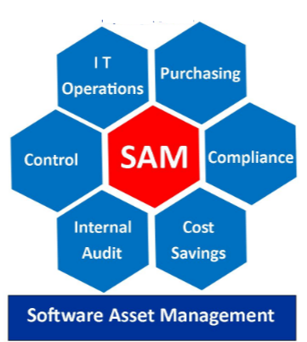
Software assets
Software used to accomplish organization’s mission
Many properties similar to hardware assets
Mainly general
Can also be idiosyncratic
E.g. locally developed utilities
Very dangerous
What happens when the developer leaves?

Slide 22
Legal assets
Contractual arrangements that guide the use of hardware and software assets within the organization
Examples
Technical support agreements, software licenses, revenue sources, and funding streams
Often forgotten as “legalese”, “fine-print” etc
Comair incident
2004

Slide 23
Asset identification – brief sample
Asset | Asset Type
Laptop | Hardware Asset
Student Grades | Informational Asset
John Doe - Security Analyst | Personnel Asset
Microsoft Office Suite | Software Asset
Microsoft Office License | Legal Asset

Slide 24
Asset characterization
Sensitivity: Damage from breach of confidentiality or integrity of an asset
Criticality: Importance of an asset to immediate survival of organization
Restricted
Disclosure or alteration would have adverse consequences for the organization
E.g. student grades
Unrestricted
Leak or modification would not have adverse consequences for the organization
E.g. Student directory
Essential asset
Loss of availability would have severe immediate repercussions for the organization
E.g. DNS server
Required asset
Organization would be able to continue for a time without the asset
E.g. learning management system
Deferrable asset
Loss of availability is tolerable
E.g. University website

Slide 25
Asset example (contd.)
Asset | Asset Type | Sensitivity | Criticality
Laptop | Hardware Asset | Restricted | Required
Student Grades | Informational Asset | Restricted | Essential
John Doe - Security Analyst | Personnel Asset | Restricted | Required
Microsoft Office Suite | Software Asset | Unrestricted | Deferrable
Microsoft Office License | Legal Asset | Unrestricted | Required

Slide 26
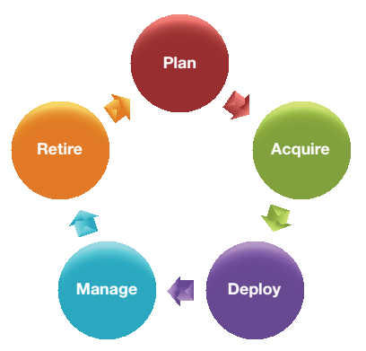
Asset lifecycle
Assets have long lives
Forgotten assets may be compromised
Assets being acquired may be candidates for compromise
Information security analyst must plan ahead for these implications
Awareness of asset lifecycle
Notes:
Stage Activities:
Planning
Request for information
Acquiring
Invitation to negotiate
Request for proposal
Invitation to bid
Deploying
Managing
Retiring

Slide 27
System profiling
Putting together all the assets inventoried, grouping them by function, and understanding the dependencies between these assets
Create big picture view of system or process

Slide 28
Asset ownership and operational responsibilities
Operational responsibility
Responsibility of an individual or entity for a specific function related to the use of an asset
Also called custodian
Clarify the roles of organizational members for all well-defined functions related to an asset
Owner
Individual or unit with operational responsibility for all unanticipated functions involved in securing an asset

Slide 29
Asset example (contd.)
Asset | Asset Type | Sensitivity | Criticality | Owner | Responsibilities
Laptop | Hardware Asset | Restricted | Required | Faculty | Deployment, backup – IT Patching – faculty
Student Grades | Informational Asset | Restricted | Essential | Registrar, fin. aid, controller | IT
John Doe - Security Analyst | Personnel Asset | Restricted | Required | IT | IT
Microsoft Office Suite | Software Asset | Un restricted | Deferrable | End user | IT
Microsoft Office License | Legal Asset | Un restricted | Required | IT | IT

Slide 30
Summary
Assets
Identification
Asset types
Characterization
Sensitivity
Criticality
Ownership
Operational responsibilities

Slide 31
Chapter Review Questions
What is an asset from the perspective of an information security professional?
While identifying assets, why is it important to start by identifying what is important to the organization?
What are the two common ways of finding out what is important to an organization?
What are general assets? Idiosyncratic assets? How are they different in terms of the effort required to identify them correctly?
What is a checklist? Why are checklists useful in busi- ness in general?18 Why are they not so useful for asset identification?
What is the purpose of the Mission Statement? The Vision Statement? How are they different?
What is an information asset? Provide some examples.
What is a personnel asset? Provide some examples.
What is a hardware asset? Provide some examples.
What is a software asset? Provide some examples.

Slide 32
Chapter Review Questions
What is a legal asset? Provide some examples.
What are some important items of information tracked for hardware assets? What is the goal of such tracking?
What is asset characterization? Why is it useful?
What is asset sensitivity? What are the different classes of sensitivity commonly used to characterize assets?
What is asset criticality? What are the different classes of criticality commonly used to characterize assets?
What is the IT asset life cycle? What are the stages in the life cycle?
What are the information security concerns during the “plan” stage of the IT asset life cycle?
What are the information security concerns during the “acquire” stage of the IT asset life cycle?
What are the information security concerns during the “deploy” stage of the IT asset life cycle?

Slide 33
Chapter Review Questions
What are the information security concerns during the “manage” stage of the IT asset life cycle?
What are the information security concerns during the “retire” stage of the IT asset life cycle?
What is system profiling? How does it affect information security?
Who is the owner of an asset?
What is operational responsibility for an asset?
Provide an example of a situation where the owner of an asset may not have operational responsibilities for the asset.

Slide 34
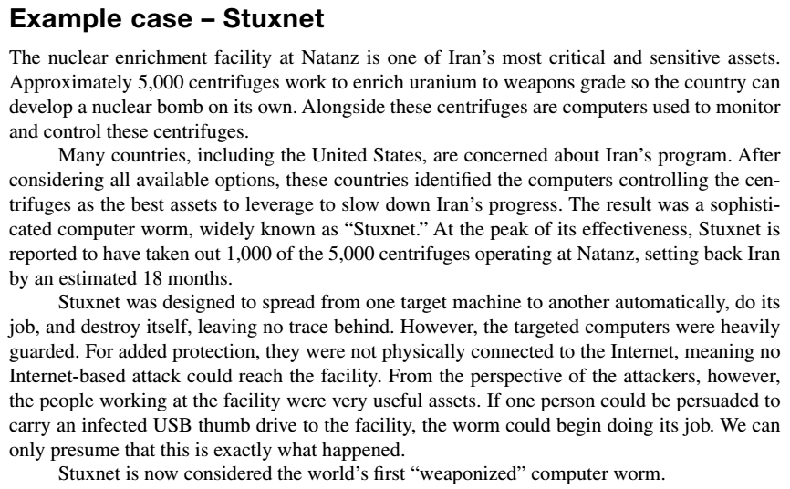
Example case: Stuxnet

Slide 35
Example Case Questions
What assets were targeted by Stuxnet and the team behind the worm?
Classify each of these assets using the asset classification scheme developed in this chapter.
Based on the information in the articles referenced in the case, Iran seems to have taken great care to identify and protect its assets at Natanz. What additional precautions could it have taken?

Slide 36
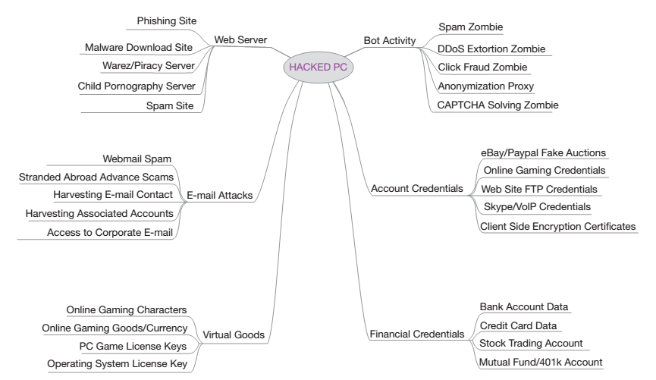
Critical Thinking Exercise
We have seen in this chapter that attackers are always looking for ways to obtain control of a computer connected to the Internet. Brian Krebs, author of the popular information security blog, krebsonsecurity, has plotted the possible uses of a compromised PC
(see http://krebsonsecurity.com/wp-content/uploads/2012/07/valueofhackedpc.png)

Slide 37
Critical Thinking Exercise Questions
If your PC were compromised, provide a brief descrip- tion of how your PC could be used by an attacker to perform any three of the above activities.

Slide 38
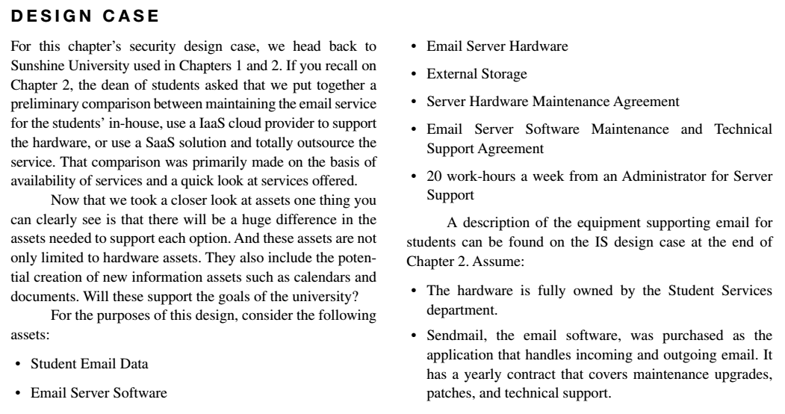
Design Case

Slide 39
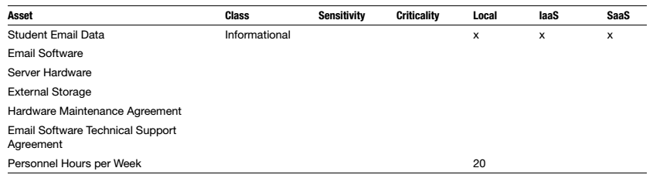
Design Case Questions
You are required to turn in a new report. In your report, include the following items. A template for listing the assets is shown below:
Classify existing assets supporting local email in terms of informational, personnel, software, hardware, or financial asset.
Can you determine the “primary” asset in your list? Which asset is central to the system, with all other assets supporting its existence?
What stage of the IT life cycle is the email server? What type of asset will be needed if a decision is made to keep email on-site?
Determine and indicate in the report which of these assets would not be required if student email is moved to an IaaS solution. Repeat the same exercise for the SaaS solution. Are local backup copies of the email data feasible with the IaaS/SaaS solutions? Why? Consider the cost impacts.

Slide 40
Design Case Questions
Will there be a learning curve with the adoption of a new off-site email system?
Determine and indicate in the report any other “hid- den” assets that are needed to support the current, on-site configuration. How will these assets change by moving to an off-site solution? Examples include the following
If you have a problem with your email account at your university, who do you call first?
How does an email “leave” the sender and “arrive” at the recipient?
If a student accidently deletes their entire Inbox, how is it recovered?
Classify each asset according to your view on their sensitivity and criticality. Justify.
Are there differences in criticality between the mail- boxes of different students?
Discuss in the report the possible timing of a switch to an off-site solution.

Slide 41
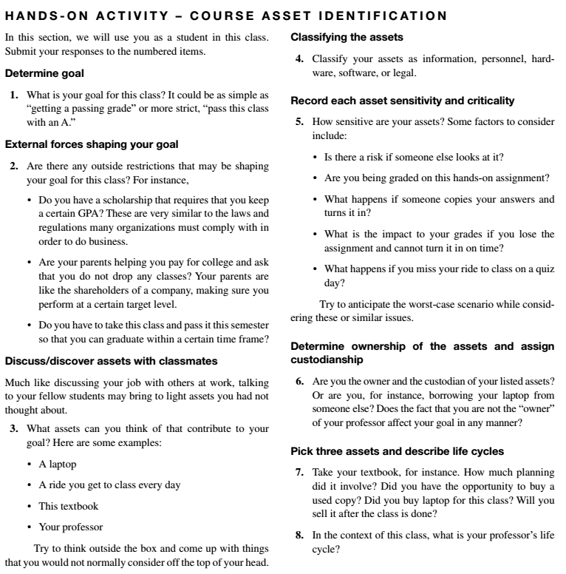
Hands-on Activity

Slide 42
Discussion 5
POST (due WED 11:59 pm CST): ﻿﻿﻿﻿﻿﻿﻿Download and install Lansweeper or Spiceworks. Use the application you have installed to discover assets on your home network or our campus. Given the assets classification scheme we have learned this week, classify the assets you have discovered and describe what information about each asset class the application gives you.
RESPONSES (due FRI11:59 pm CST): Respond to two of your peers' posts. Does the application, as your peer has used it, allow him or her to complete a full and comprehensive profile of the assets on his or her network? Why or why not?

Slide 43
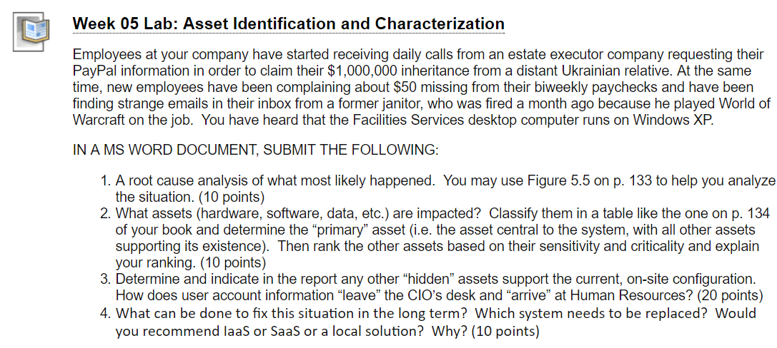
Homework Lab_5

Slide 44
For Next Week
# | Topic | Reading | Due Sunday 11:59 pm CST on Blackboard
6 | Asset Identification and Characterization: IT asset lifecycle and asset identification, system profiling, Asset ownership and operational responsibilities | Agrawal 5 Other materials on Blackboard | W: Post F: Responses S: LAB_5

